Slide 1

Swati Mali
swatimali@somaiya.edu

Slide 2

An agent is anything that can be viewed as perceiving its environment through sensors and acting upon that environment through actuators
E.g Human Being

Slide 3

Percept
Percept history
Environment
Actuator
Sensors

Slide 4


The agent function maps from percept histories to actions:[f: P* → A]
The agent program runs on the physical architecture to produce f
agent = architecture + program

Slide 5

Environment
Sensors
  May also include keystrokes, file contents, and network packets, voice commands/wakeup words
Actuators
  May also include displaying on the screen, writing files, and sending network packets
Program logic

Slide 6

agent function is an abstract mathematical description;
the agent program is a concrete implementation, running on the agent architecture.

Slide 7

An agent should strive to "do the right thing", based on what it can perceive and the actions it can perform.
The right action is the one that will cause the agent to be most successful
Performance measure: An objective criterion for success of an agent's behavior
E.g: performance measure of a vacuum-cleaner

Slide 8
Rational Agent: For each possible percept sequence, a rational agent should select an action that is expected to maximize its performance measure, given the evidence provided by the percept sequence and whatever built-in knowledge the agent has.

Slide 9

Agentic AI = AI systems that can plan, reason, act, use tools, and collaborate over extended time without constant human prompting.
Examples
  ChatGPT with tools
  AutoGPT
  Devin (AI software engineer)
  AI research agents
  AI customer support agents

Slide 10
Rationality is distinct from omniscience
Agents can perform actions in order to modify future percepts so as to obtain useful information
An agent is autonomous if its behavior is determined by its own experience

Slide 11

PEAS
Must first specify the setting for intelligent agent design
Consider, e.g., the task of designing an automated taxi driver:
  Performance measure
  Actuators
  Sensors
  Environment

Slide 12


Performance measure
  gold +1000, death -1000
  -1 per step, -10 for using the arrow
Environment
  4 X 4 grid of rooms
  Agent always starts in square [1,1], facing to right
  Squares adjacent to wumpus are smelly
  Squares adjacent to pit are breezy
  Glitter iff gold is in the same square
  Shooting kills wumpus if you are facing it
  Shooting uses up the only arrow
  Grabbing picks up gold if in same square
  Releasing drops the gold in same square
Sensors: Stench, Breeze, Glitter, Bump, Scream
Actions: Left turn, Right turn, Forward, Grab, Release, Shoot
Actuators : wheel/feet, arm

Slide 13

Performance measure: Safe, fast, legal, comfortable trip, maximize profits
  Assign measurable points
Environment: Roads, other traffic, pedestrians, customers, signals
Actuators: Steering wheel, accelerator, brake, signal, horn, speaker
Sensors: Cameras, sonar, speedometer, GPS, odometer, engine sensors, keyboard, microphone

Slide 14
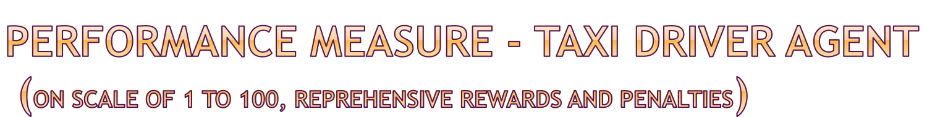
Legal
  Breaking signal ➔ -40 per signal break
  Speeding ➔ -20 per speed limit violation
  Wrong entry ➔ -30 for every wrong entry
  Wrong parking => -20 for every wrong parking
  Minor accident ➔ -70 for every minor accident
  Major accident ➔ -100 for every major accident
  Kill anyone in accident -> -10,000
  Save someone but lose vehicle in attempt - > -5000
Safe
Maximize profit
Comfortable journey
  Avoiding pothole ➔ +40 per pothole
  Speeding at speedbreakers ➔ -30
  Sudden break ➔ -30

Slide 15

Performance measure: Healthy patient, minimize costs, lawsuits
Environment: Patient, hospital, staff
Actuators: Screen display (questions, tests, diagnoses, treatments, referrals)
Sensors: Keyboard (entry of symptoms, findings, patient's answers), mouse

Slide 16

Performance measure: Percentage of parts in correct bins, percentage of broken parts during picking, work speed/ minimum displacement of robotic arm
Environment: Conveyor belt with parts, bins
Actuators: Jointed arm and hand
Sensors: Camera, joint angle sensors

Slide 17

Performance measure: ?
Environment: ?
Actuators:?
Sensors:?

Slide 18

Fully observable (vs. partially observable): An agent's sensors give it access to the complete state of the environment at each point in time.
Deterministic (vs. stochastic): The next state of the environment is completely determined by the current state and the action executed by the agent.
Episodic (vs. sequential): The agent's experience is divided into atomic "episodes" (each episode consists of the agent perceiving and then performing a single action), and the choice of action in each episode depends only on the episode itself.

Slide 19
Static (vs. dynamic): The environment is unchanged while an agent is deliberating.
Discrete (vs. continuous): A limited number of distinct, clearly defined percepts and actions.
Single agent (vs. multiagent): An agent operating by itself in an environment.

Slide 20

Vacuum cleaning agent?
Chess playing agent?
Kitchen cleaning agent ?
Interactive receptionist?
Taxi driving agent?
Wumpus world player?
Pro-kabaddi referee agent?
PUBG?

Slide 21

An agent is completely specified by the agent function mapping percept sequences to actions
Aim: find a way to implement the rational agent function concisely

Slide 22

Function TABLE-DRIVEN(percepts)
returns an action
Input: Static : percepts,
table
append percept to the end of percept sequence
action ← LOOKUP(percepts,table)
return action

Slide 23

Drawbacks:
  Huge table
  Take a long time to build the table
  no agent could ever learn all the right table entries from its experience
  even if the environment is simple enough to yield a feasible table size, the designer still has no guidance about how to fill in the table entries

Slide 24

Four basic types in order of increasing levels of intelligence and complexity:
Simple reflex agents
Model-based reflex agents
Model-based Goal-based agents
Model-based Utility-based agents
Learning Agent- contains one of the above architectures as a component (Performance Element)

Slide 25

Rule-based Agents (1990s)
→ Model-based Agents
→ Learning Agents
→ Deep Learning Agents
→ LLM-based Agents
→ Agentic AI (Autonomous, Tool-using, Multi-agent)

Slide 26



Slide 27
Select action based on current percept
Ignore the rest percept history
Simple but limited intelligence.
if car-in-front-is-braking then initiate-braking.

Slide 28

Function VACCUME-CLEANER(loc,status) returns an action
If status = dirty then return suck-Dirt
else if loc= A then return Right
else if loc= B then return left

Slide 29

Function Simple-reflex(percept) returns an action
Input: Static: rules
State ← INTERPRET-INPUT(percept)
Rule← RULE-MATCH(state,rules);
Action← RULE-ACTION(rule);
Return action

Slide 30

work only if the correct decision can be made on the basis of only the current percept, i.e. only if the environment is fully observable.
Even a little bit of unobservability can cause serious trouble
  E.g single image may not be sufficient to know whether the car in front is braking.
Doesn’t act on its own; would always require an external action for the agent to perform a reflex action

Slide 31
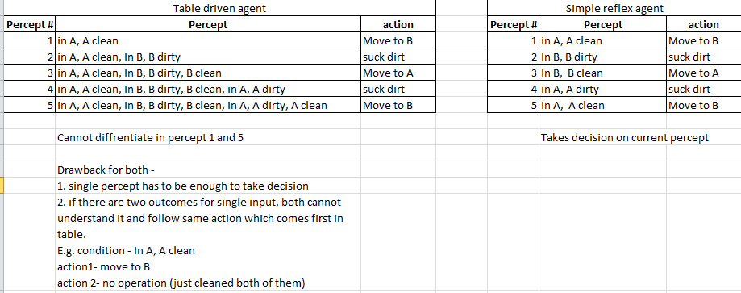

Slide 32
Sr no | Percept | action
 | Baby crying | Give food
 | Baby crying | Play
 | Baby crying | Read a story
 | Baby crying | Put to sleep
 | Baby crying | Sing a song
The table driven or simple reflex agent cant take different action for same percept

Slide 33



Slide 34

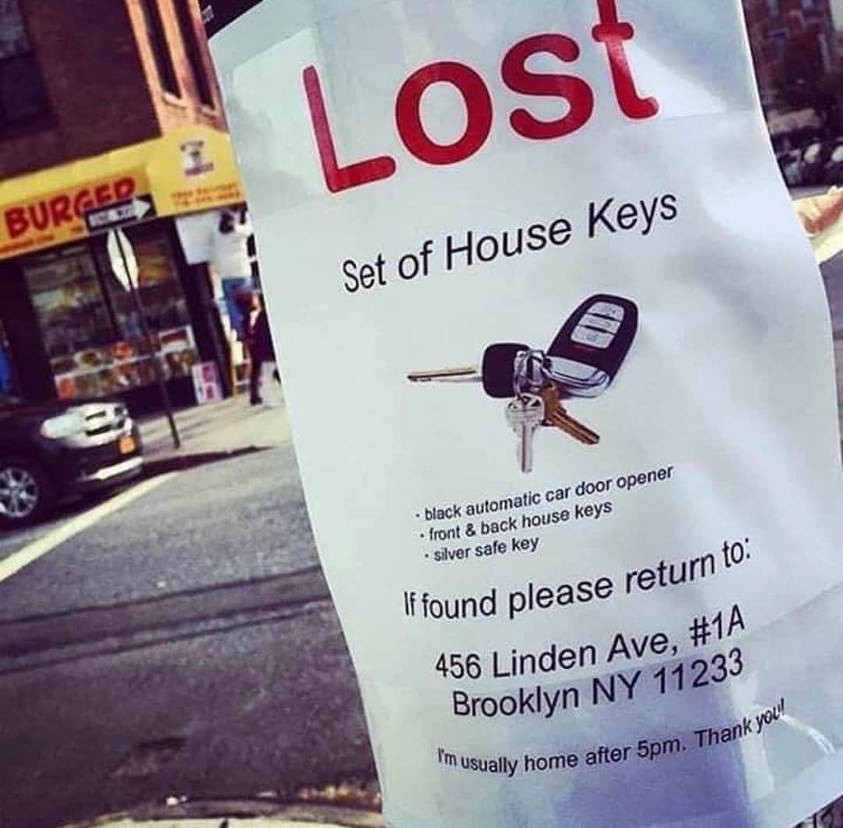


Slide 35
Keep track of the world current state.
Knows how world evolves
Keep track of the unseen part of world
internal state requires two kinds of knowledge
  Information about how the world evolves independently of the agent
  How the agent's own actions affect the world

Slide 36

For the braking problem, the internal state is not too extensive just the previous frame from the camera, allowing the agent to detect when two red lights at the edge of the vehicle go on or off simultaneously.
For other driving tasks such as changing lanes, the agent needs to keep track of where the other cars are if it can't see them all at once.

Slide 37

Function Model-reflex(percept) returns an action
Input: state,rules, action
State ← UPDATE-STATE(state,action,percept)
Rule← RULE-MATCH(state,rules);
Action← RULE-ACTION(rule);
Return action
*UPDATE-STATE updates the internal state of the agent function.

Slide 38

Drawbacks
No goal achievement

Slide 39



Slide 40

Agent needs some sort of goal information that describes situations that are desirable
  E.g. automated taxi driver can achieve goal iff knows the passenger destination
Combines action results with desired goals
A goal condition may be satisfied just with one action or may take series of actions

Slide 41

In reflex based, built-in rules map directly from percepts to actions
  E.g. reflex agent brakes when it sees brake lights
goal-based agent could reason given the way the world usually evolves and takes the only action that will achieve the goal
  it will slow down to achieve the goal of not hitting other cars instead of apply brakes
Reflex based have to rewrite many condition-action rules to solve new problem.
The goal-based agent's behavior can easily be changed to go to a different location.

Slide 42
Efficient,
More flexible because the knowledge that supports its decisions is represented explicitly and can be modified
  E.g. in rainy season, the agent can update its knowledge of how effectively its brakes will operate; this will automatically cause all of the relevant behaviors to be altered to suit the new conditions

Slide 43

Achieve goal - problem solving through searching
  Uninformed search –BFS,DFS, DLS, IDS, Uniform Cost Search, Bidirectional search
  Informed search-best first, A*, IDA*
  Local search- Hill climbing, genetic algorithms simulated annealing, constraint satisfaction
  Adversarial search – MaxMin algorithm, alpha-beta pruning
Achieve goal through planning
  Partial order planning
  Total order planning

Slide 44


Slide 45

Goals alone are not really enough to generate high-quality behavior in most environments.
Utility based agents use more than general performance measure that allows a comparison of different world states in different degrees of happiness.
"happy" does not sound very scientific, the customary terminology is to say that if one world state is preferred to another, then it has higher utility for the agent.
Best suited for decision making agents that must handle the uncertainty inherent in partially observable environments.

Slide 46

A utility function maps a state (or a sequence of states) onto a real number, which describes the associated degree of happiness.
A complete utility function allows rational decisions in two kinds of cases where goals are inadequate.
  First, when there are conflicting goals, only some of which can be achieved, the utility function specifies the appropriate tradeoff.
  Second, when there are several goals that the agent can aim for, none of which can be achieved with certainty, utility provides a way in which the likelihood of success can be weighed up against the importance of the goals.

Slide 47



Slide 48
Simple reflex learning agent
  Mobile keyboard sugestions
Model based reflex learning agent
  http://en.akinator.com/personnages/jeu
Goal based learning agent
  MYCIN
Utility based learning agent
  Taxi Driving agent
  Any service offering agent

Slide 49
Turing proposed to build learning machines and then to teach them.
Learning has another advantage: it allows the agent to operate in initially unknown environments and to become more competent than its initial knowledge alone might allow.

Slide 50

learning element is responsible for making improvements, and the performance element is responsible for selecting external actions.
The performance element is what was previously considered to be the entire agent: it takes in percepts and decides on actions.
The learning element uses CRITIC feedback and determines how the performance element should be modified to do better in the future.
The design of the learning element depends very much on the design of the performance element.
Given an agent design, learning mechanisms can be constructed to improve every part of the agent.

Slide 51

The critic is necessary because the percepts themselves provide no indication of the agent's success.
  E.g a percept may receive checkmating opponent, but it needs a performance standard to know that this is a good thing; the percept itself does not say so.

Slide 52

problem generator is responsible for suggesting actions that will lead to new and informative experiences.
The performance element would keep doing the actions that are best, given what it knows.
But agent may explore a little and do some perhaps suboptimal actions in the short run, it might discover much better actions for the long run.
It’s job is to suggest these exploratory actions

Slide 53

The performance element : collection of knowledge and procedures for selecting its driving actions.
  The taxi goes out on the road and drives, using this performance element.
The critic: observes the world and passes information along to the learning element.
learning element: with i/p from critic, formulate a rule saying if actions was good or bad, and then modify performance element by installing the new rule.
The problem generator might identify certain areas of behavior in need of improvement and suggest experiments.
  E.g. trying out the brakes on different road surfaces under different conditions

Slide 54

Three major issues:
Which components of the performance element are to be learned.
What feedback is available to learn these components.
(*What not to take as a feedback)
What representation is used for the components.

Slide 55


